Slide 1
Fetch and React Animations

Slide 2
Objectives
Install Fetch in your React application
Use Fetch to communicate from your React application with a REST API server
Add subtle animations using the react-transition-group
Add additional component animations using react-animation-components

Slide 3
Fetch

Slide 4
Promise
Promise is a mechanism that supports asynchronous computation
Proxy for a value not necessarily known when the promise is created:
It represents a value that may be available now, or in the future, or never

Slide 5
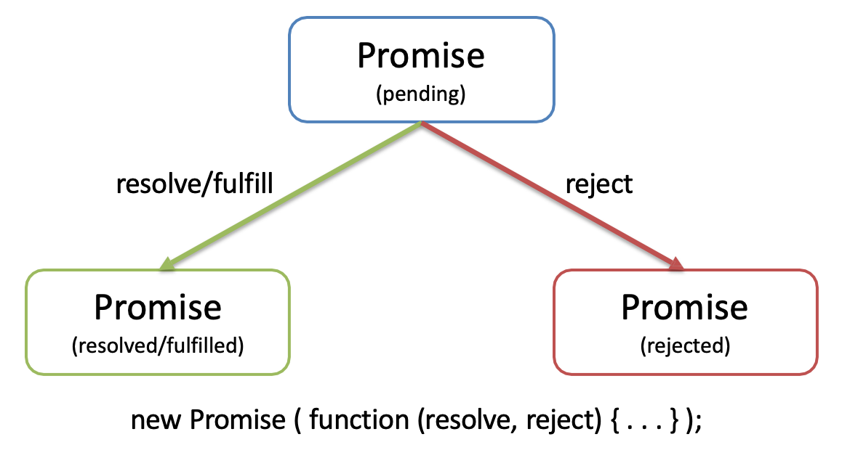
Promise

Slide 6
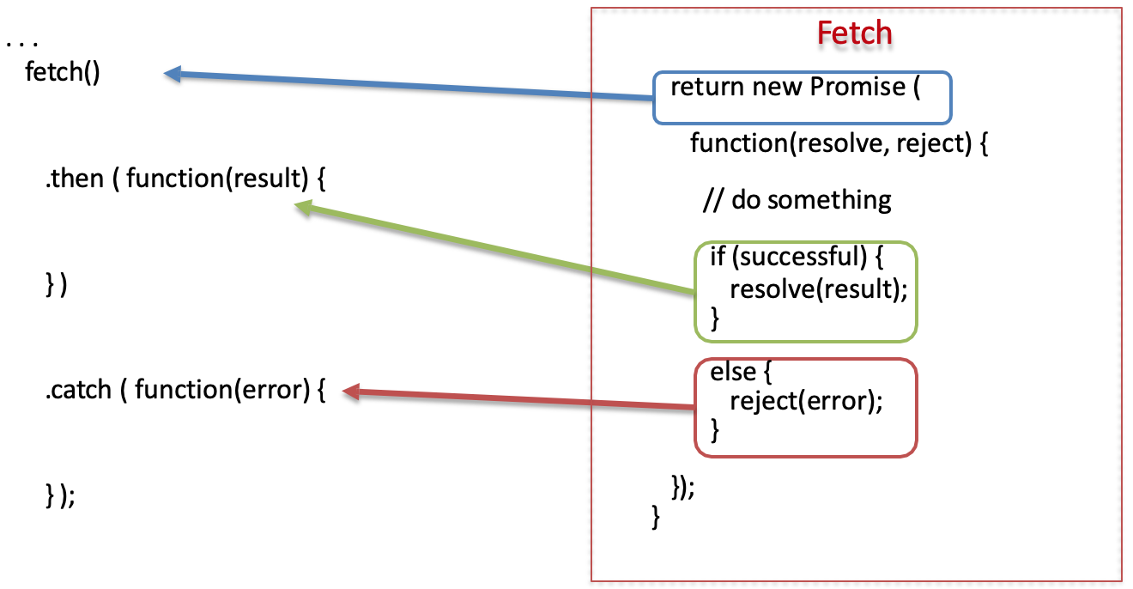
Promise Example

Slide 7
Why Promises?
Solves the callback hell (heavily nested callback code) problem
Promises can be chained
Can immediately return:
Promise.resolve(result)
Promise.reject(error)

Slide 8
Fetch
XMLHttpRequest() is quite cumbersome and outdated
Has been made palatable by wrapping it appropriately in most JavaScript libraries like jQuery as Ajax
The Fetch API is a modern replacement for XMLHttpRequest
Provides an interface for fetching resources (including across the network)
More powerful and flexible feature set
Promise based

Slide 9
Fetch Abstractions
Request: Represents a resource request
Response: Represents the response to a request
Headers: Represents response/request headers, allowing you to query them and take different actions depending on the results
Body: Provides methods relating to the body of the response/request, allowing you to declare what its content type is and how it should be handled

Slide 10
Fetch Usage
fetch(baseUrl + ‘dishes’)
.then(response => response.json())
.then(data => console.log(data))
.catch(error => console.log(error.message));

Slide 11
Fetch Posting Data
fetch(baseUrl + 'comments', { method: 'POST’,
body: JSON.stringify(newComment), headers: {
'Content-Type': 'application/json’
},
credentials: 'same-origin’
})

Slide 12
Fetch Dealing with Errors
fetch(baseUrl + 'dishes’)
.then(response => {
if (response.ok) {
return response;
}
else {
var error = new Error('Error ' + response.status + ': ' + response.statusText); error.response = response;
throw error;
}
},
error => {
var errmess = new Error(error.message); throw errmess;
})
.then(response => response.json())
.then(data => console.log(data))
.catch(error => console.log(error.message));

Slide 13
Cross-Fetch
Cross-Fetch library provides support for Fetch both in Node applications and Browsers
Uses whatwg-fetch polyfill in browsers that do not have fetch support
Uses node-fetch for Node applications on the server
To use in the application:
import fetch from ‘cross-fetch’;

Slide 14
Fetch Alternatives
Axios
Superagent

Slide 15
Exercise 42: Fetch from Server
Incorporate Fetch into your React app
Use Fetch to communicate with the REST API server

Slide 16
Exercise 43: Fetch Handling Errors
Configure your app to appropriately handle errors encountered while communicating with the server

Slide 17
Exercise 44: Fetch Post Comment
Configure Fetch to post data to the server
Receive and process the response to the POST operation on the server

Slide 18
React Animations

Slide 19
React Animations
Animations in React can be supported through several React animation libraries
Two that we will explore in this course:
React-transition-group
React-animation-components

Slide 20
React Transition Group
A set of components for managing component states (including mounting and unmounting) over time, specifically designed with animation in mind
Components supported:
Transition
CSSTransition
TransitionGroup

Slide 21
Transition
Lets you describe a transition from one component state to another over time
entering, entered, exiting, exited
Used to animate the mounting and unmounting of a component
The in prop is used to toggle the transition state
When true the component begins the sequence of entering → entered state
Timeout specifies the duration spent in the entering state

Slide 22
CSS Transition
CSS Transition applies a pair of class names during the appear, enter and exit stages of the transition
Uses the in prop to decide when to apply the transition classes
Example:
<CSSTransition key={this.props.location.key} classNames="page" timeout={300}>
Should define .page-enter, .page-enter-active, .page-exit, .page-exit- active CSS classes

Slide 23
Transition Group
Manages a set of <Transition> components in a list
Automatically toggles the in prop for the components

Slide 24
React Animation Components
A set of react components implemented using react- transition-group
Provides drop in GPU accelerated animations and wrappers for group effects
Animation components
Fade, Transform, FadeTransform
Wrapper components
Stagger, Random, Loop

Slide 25
Exercise 45: React Animations
Configure your app to use react-transition-group for animations
Implement simple animation using the react-transition-group

Slide 26
Exercise 46: React Animation Components
Use react-animation-components to add more subtle animations to your React app.

Slide 27
Summary
Install Fetch in your React application
Use Fetch to communicate from your React application with a REST API server
Add subtle animations using the react-transition-group
Add additional component animations using react-animation-components

